Slide 1
EDTECH STARTUP DATA ANALYSIS PROJECT USING POWERBI

Slide 2
You are a data analyst working with an EdTech startup that wants to grow its offerings in recorded lectures. The company has collected data from various EdTech websites but needs your expertise to make sense of it.
Your task is to clean and analyse this data to uncover valuable insights. To ensure the startup can effectively leverage this information, you will create a dashboard that presents following insights. Your analysis will help the company identify areas for improvement and opportunities for growth in their recorded lecture services.
PROBLEM STATEMENT

Slide 3
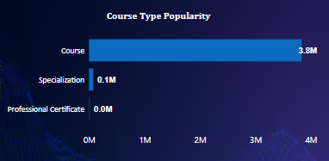
EXAMINE THE DISTRIBUTION OF COURSE TYPES ACROSS CATEGORIES
Insights Obtained
From the analysis, it is obtained that generally,Learners are enrolling themselves in courses more frequently than in specialized programs or professional certificates among all the specific categories(i.e. data science , business etc).

Slide 4
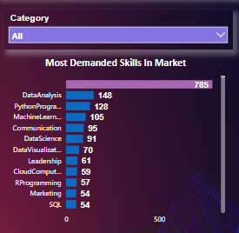
MOST COMMONLY DEMANDED SKILLS IN MARKET
Insights Obtained
Data Analysis , Python Programming ,Machine Learning etc are the top 3 demanded skills in the market .Apart from technical skills , soft skills like Communication is crucial in the current market as well.

Slide 5

RECOMMENDATIONS ON THE BASIS OF INSIGHTS
From the analysis, I recommend my client prioritize launching courses across all key categories, such as Data Science, Business, and IT, to achieve maximum impact and better align with learner demand.
Focus on high demand skills such as Data Analysis, Machine learning etc , offer comprehensive programs or courses in thses areas ,would align with learner demand and attract a large audience.
Blend Technical and Soft Skills: While technical skills dominate, there is also a significant demand for Communication and Leadership skills. Consider launching courses that integrate technical expertise with soft skills to provide better learning experiences and to enhance user engagement.

Slide 6
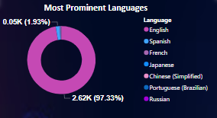
DISTRIBUTION OF VARIOUS LANGUAGES IN PARTICULAR COURSE
Insights Obtained
English is the dominent language for a particular course.It simply shows that ,majority of learners are prefering in particular english language of courses .

Slide 7
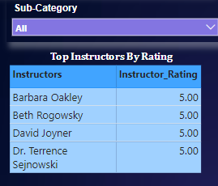
TOP INSTRUCTORS FOR EACH CATEGORY AND SUBCATEGORY BASED ON RATINGS
Insights Obtained
It highlights the top instructors for each sub-category of courses, with all listed instructors achieving a perfect rating of 5.0. This insight empowers the client to dynamically identify high rated instructors and can leverage these highly-rated instructors to market their courses more effectively.

Slide 8
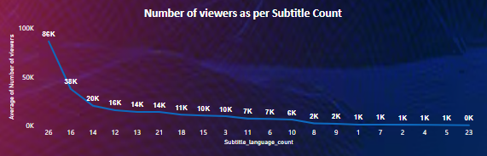
RELATIONSHIP BETWEEN THE AVAILABILITY OF SUBTITLES AND THE NUMBER OF VIEWS FOR COURSES
Insights Obtained
From this analysis , can say 26 and 16 subtitle count showing the higher avg no. of viewers ,indicating a strong user engagement.

Slide 9
RECOMMENDATIONS ON THE BASIS OF INSIGHTS
As majority of learners prefer courses offered in English language.Make sure lauch or create courses in english language for the ease and comfortability of the learners or professionals.
Showcase top-rated instructors for specific sub-categories on the platform. This will help learners make informed decisions by highlighting the best educators in their desired fields, while also enhancing the platform's credibility and attracting more users to enroll in courses led by highly-rated instructors.
Provide course content with subtitles in 16 or more languages. This strategy is likely to increase user engagement and the chances of course purchases, as courses with 16 and 26 subtitles show the highest average viewership. Expanding subtitle options enhances accessibility and caters to a more diverse audience, ultimately driving growth in course enrollments.

Slide 10
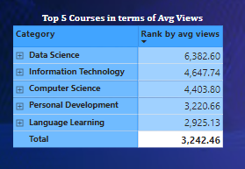
TOP 5 CATEGORIES BASED ON VIEWERS (AVG VIEWES)
Insights Obtained
Here ,are the top 5 Course Categories i.e Data Science and IT etc in terms of highest avg viewers.
It can be determined easily ,viewers show preferences for technical and professional skill -oriented categories.

Slide 11
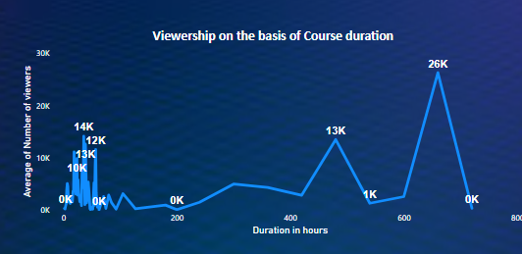
RELATIONSHIP BETWEEN COURSE DURATION AND THE NUMBER OF VIEWS
Insights Obtained
Beyond 200 and 600 hours course duration ,the viewership is increasing but not uniformaly in all cases. This indicates that longer duration of courses might attract more viewers in some instances.

Slide 12
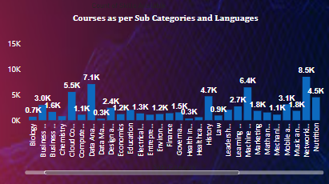
CALCULATE THE AVERAGE NUMBER OF VIEWS FOR EACH CATEGORY ,SUB-CATEGORY AND LANGUAGE
Insights Obtained
This visual allows to dynamically explore the average number of viewers for each sub-category and the corresponding languages offered. It is analyzed that, for each sub-category, English is the best-performing language in terms of viewership.

Slide 13
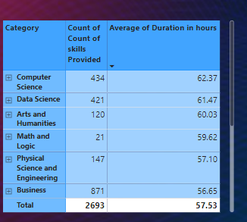
COUNT OF VARIETY OF SKILLS IMPACT ON VIWERSHIP
Insights Obtained
Course Categories like Computer science and Data science etc are offering greater number of skills and yes positively influences viewership and learner engagement.

Slide 14
RECOMMENDATIONS ON THE BASIS OF INSIGHTS
From the analysis part ,it could be recommended that carefully design courses with durations around 200 and 600 hours, as these durations show a potential for higher viewership.
Focus on maintaining high-quality content, aligning the course topics with market demand such as Data Science , Computer Science and Personal development etc.And make sure , deliver the maximum course content in english language
To enhance viewership further, should consider expanding the variety of skills offered in popular categories like Computer Science, Data Science and Art and Humanities to maximize learner engagement .

Slide 15
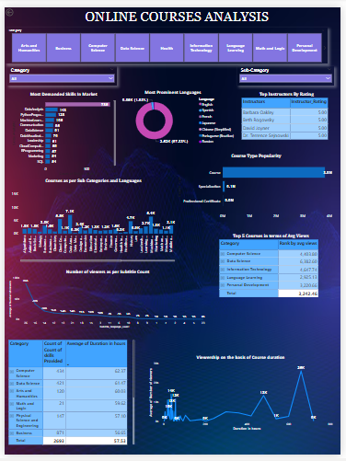
Online Courses Analysis Dashborad in PowerBi

Slide 16
THANK YOU !!
Presented by Anshika

